Slide 1
zPanel CMS 4.0
One way to make whatever kind of your website much more EASIER!

Slide 2
Introduction
Updating content of website is very EASY with zPanel 4.0.
Compared to the older version, zPanel 4.0 now have a lot of new features.
Using Virtual Dynamic DBMS (Database Management System), no need to set up phpmyadmin every time you build fresh new website.

Slide 3
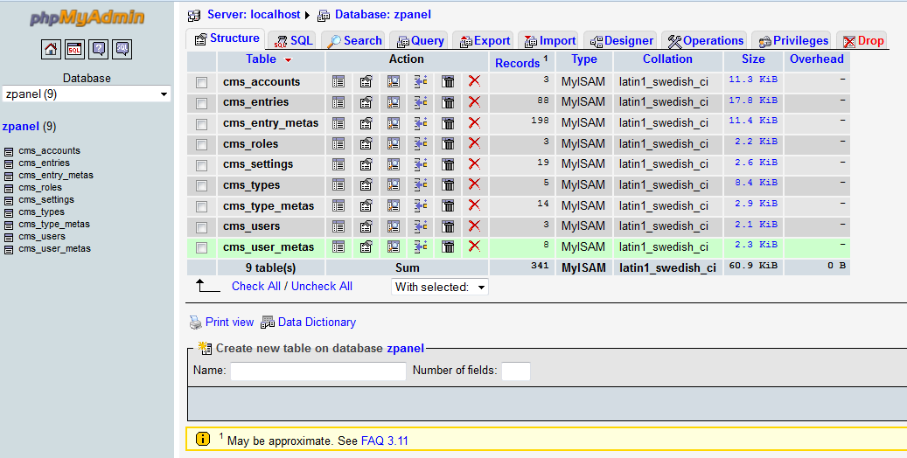
phpMyAdmin Web DBMS

Slide 4
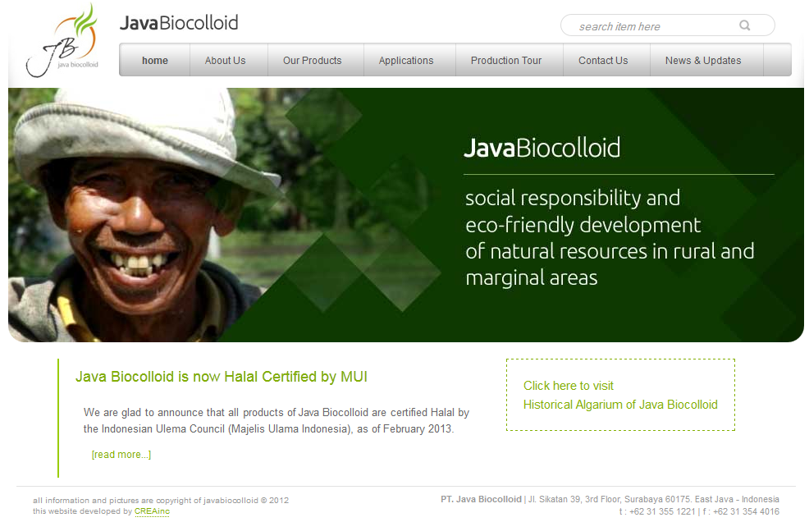
CMS Front-End Layout

Slide 5
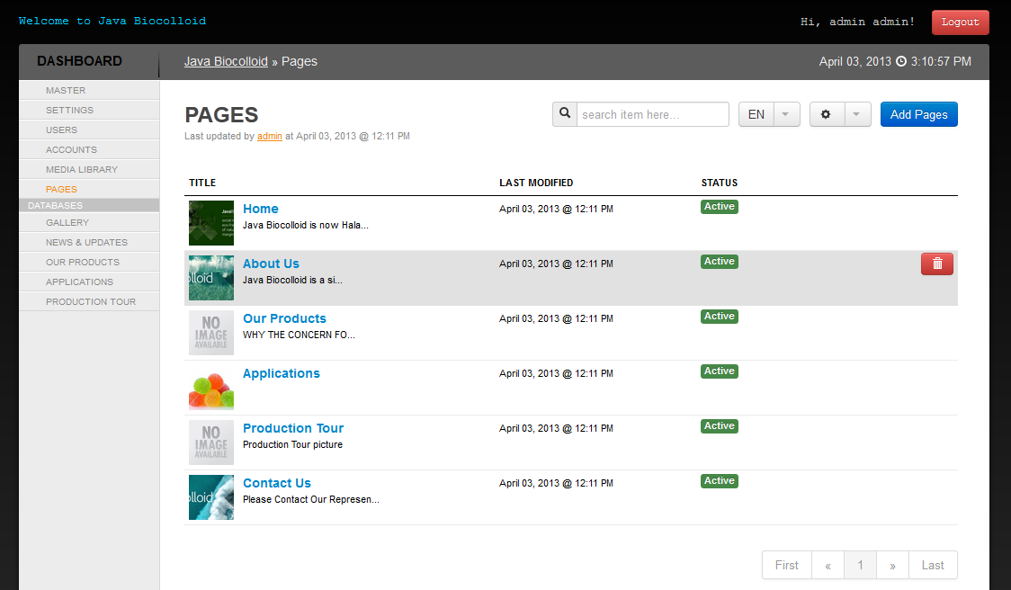
CMS Back-End Layout

Slide 6
9 New Features
Web Global Settings in ONE form.
Users can have multiple accounts (hybrid).
Master Database (just like phpmyadmin).
All images is all grouped in Media Library.
Automatic input data form generation.

Slide 7
9 New Features (cont.)
Uploaded images are now facilitated with options (No / Auto / Manual Crop).
Multi-language applied.
Order of content can be arranged manually.
Front-End Content Editor (Stagging).

Slide 8
Web Global Settings
Basic Settings.
Page Inserts.
Media Settings.
Customized Settings.

Slide 9
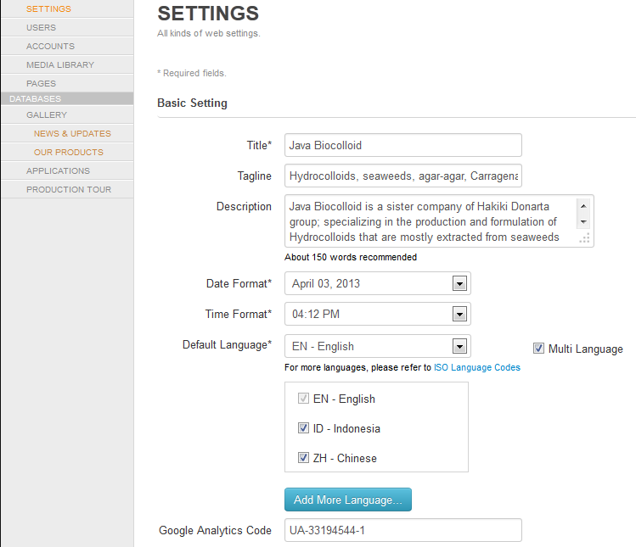

Slide 10
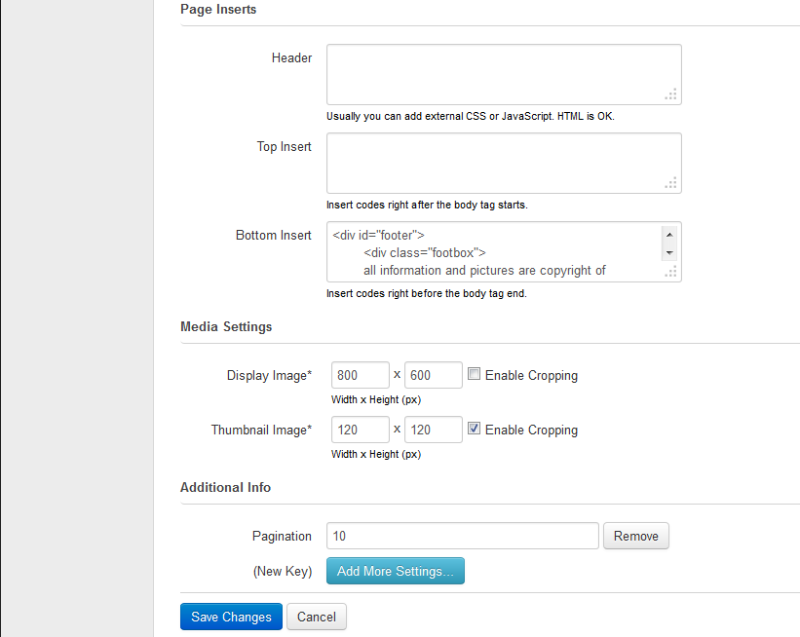

Slide 11
Users & Accounts
One account one role (Super admin, administrator, reguler user, or even set your custom role).
One user can have more accounts.
Example: User Andy Basuki can log-in to website as administrator, or as reguler user (differed in website access priviledges).

Slide 12
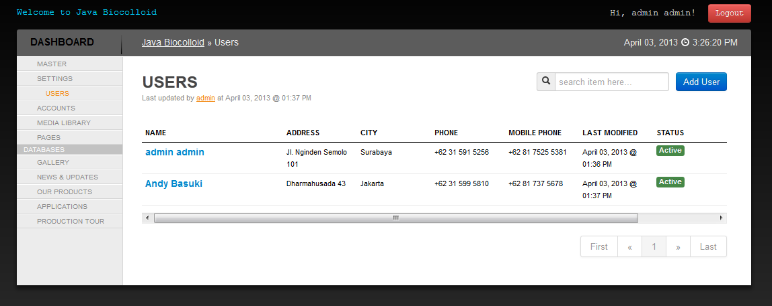
Users Module

Slide 13
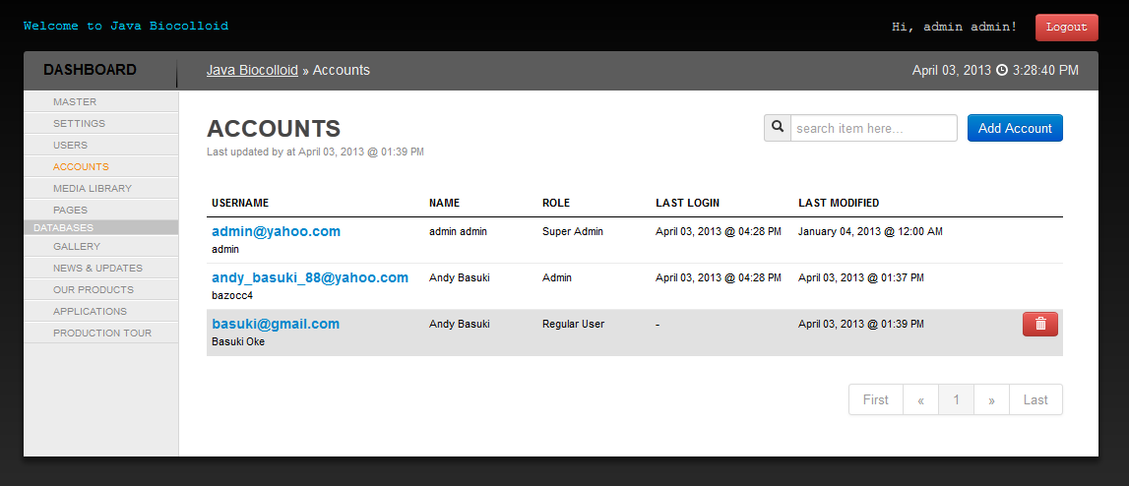
Account Module

Slide 14
Master Database
Creating website database is not in phpmyadmin anymore, but directly INSIDE YOUR WEBSITE.
Data inheritance now applied (parent & children data).
Client doesn’t need to know these features (these are our sell value).

Slide 15
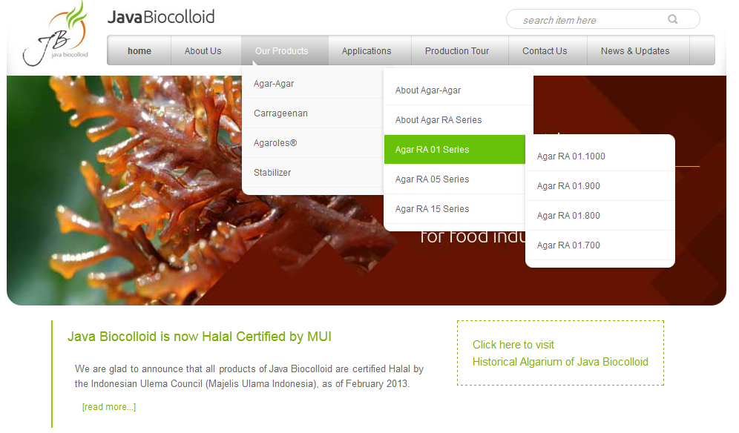
Master Database (cont.)

Slide 16
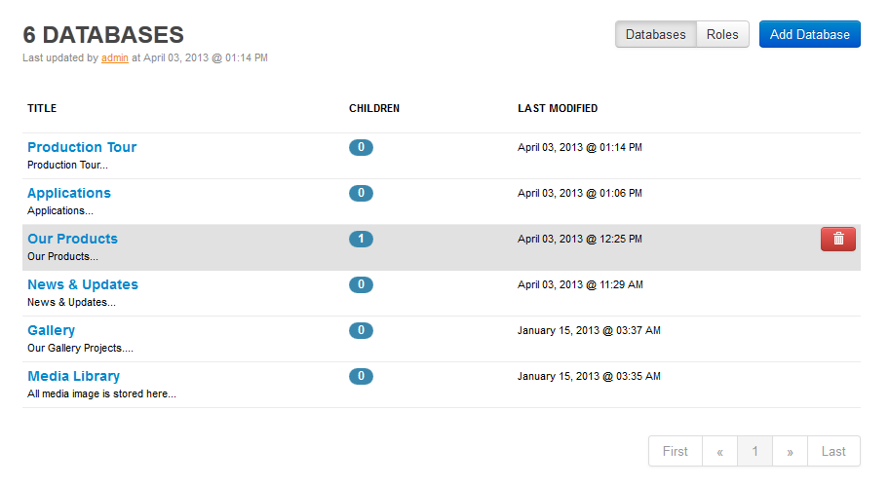
Master Database (cont.)

Slide 17
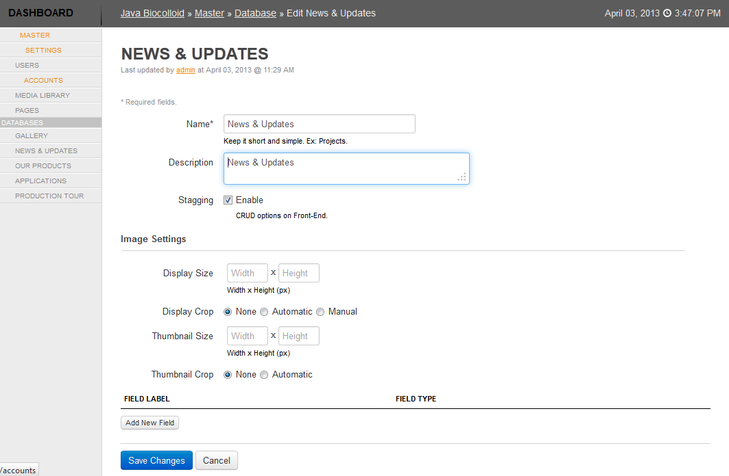

Slide 18
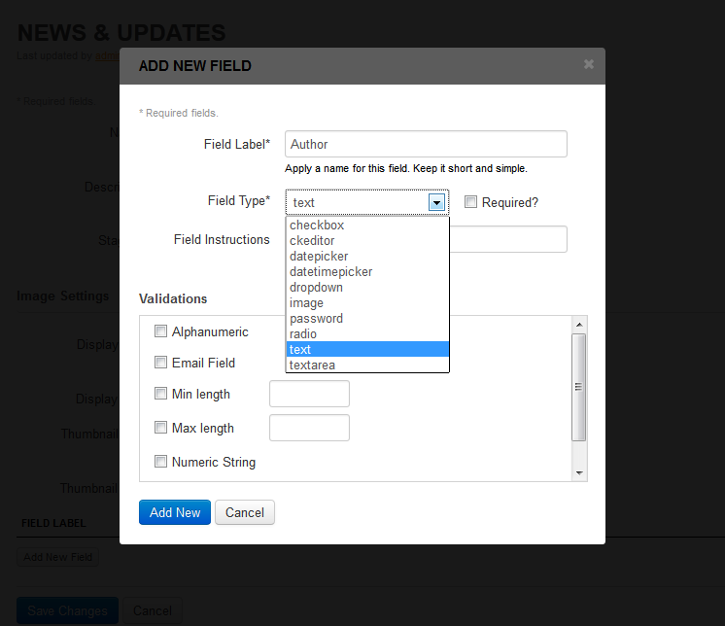

Slide 19
Media Library
Upload multiple images just in one click.
Every website content grab image from here.

Slide 20
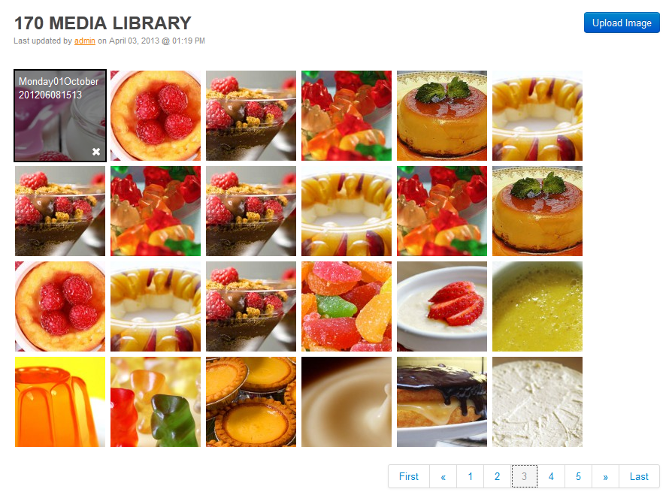

Slide 21
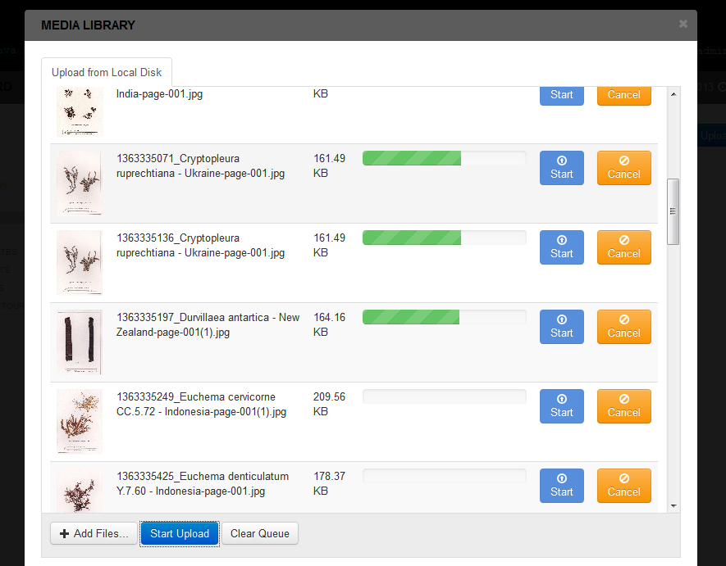

Slide 22
Content Form Generation
Programmer no need to set up every content input form, it is automatically generated from system.
Custom input type content applied.

Slide 23
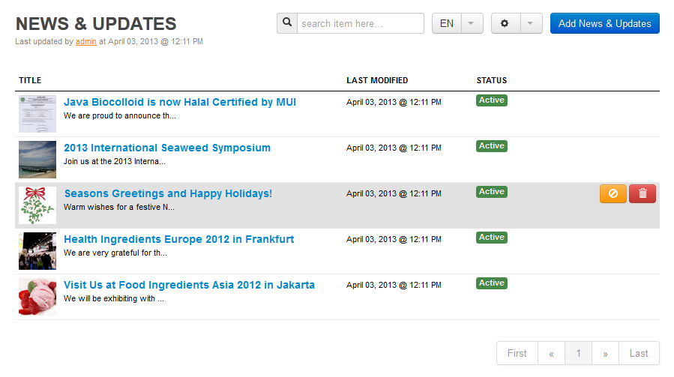
Content Form Generation (cont.)

Slide 24
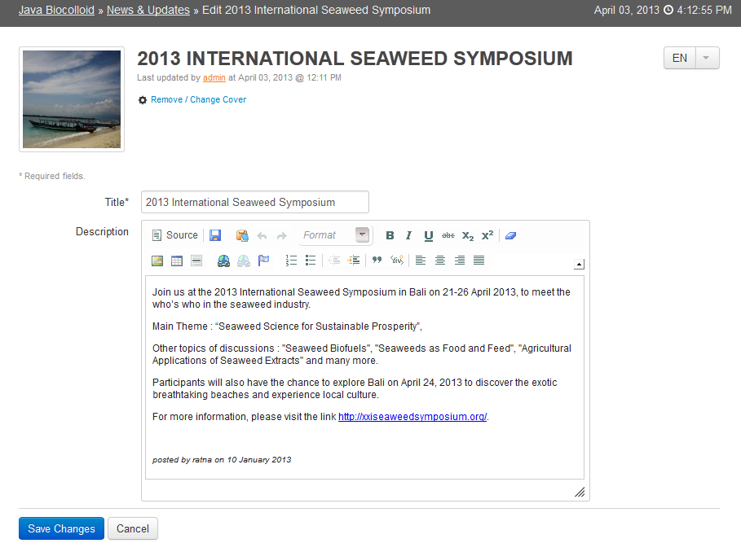

Slide 25
Uploaded Image Options
Sometimes images that being uploaded have too large size in dimension (width / height).
zPanel have features to resize that in 3 ways:
No Crop (just resize normally)
Automatic Crop
Manual Crop

Slide 26
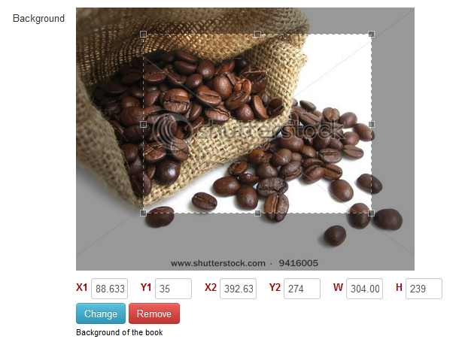
Manual Crop Option

Slide 27
Multi-Language
Sometimes people need website that powerful enough having multiple language in contents.
Google translate doesn’t guarantee its translation is good and valid.
Every content of website can have more than one language.

Slide 28
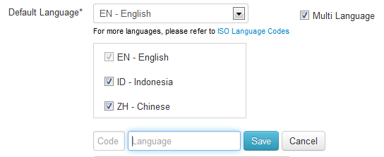
Multi-Language (cont.)
Add unlimited kind of language from website settings.

Slide 29
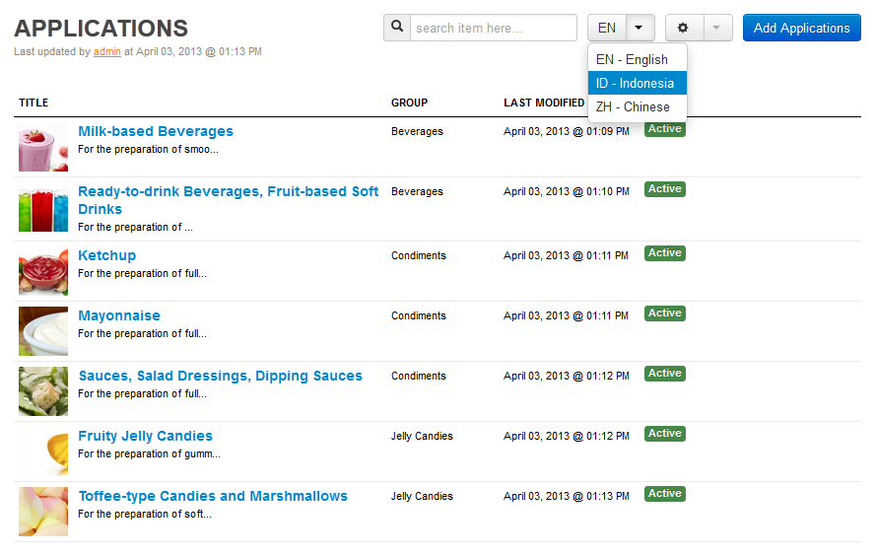
Multi-Language (cont.)

Slide 30
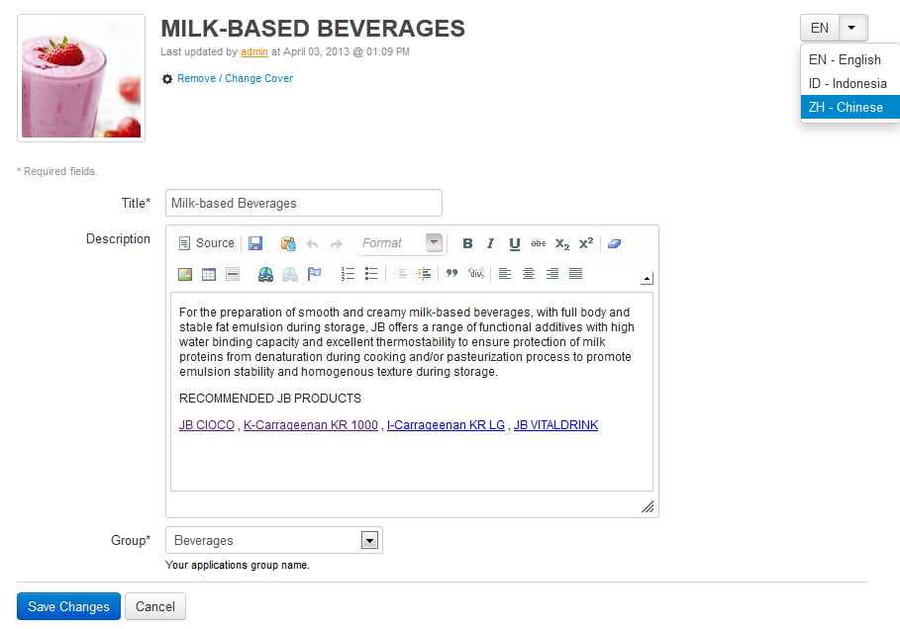

Slide 31
Rearrange Content
Sometimes you need to rearrange the content order sequence when website had already launched.

Slide 32
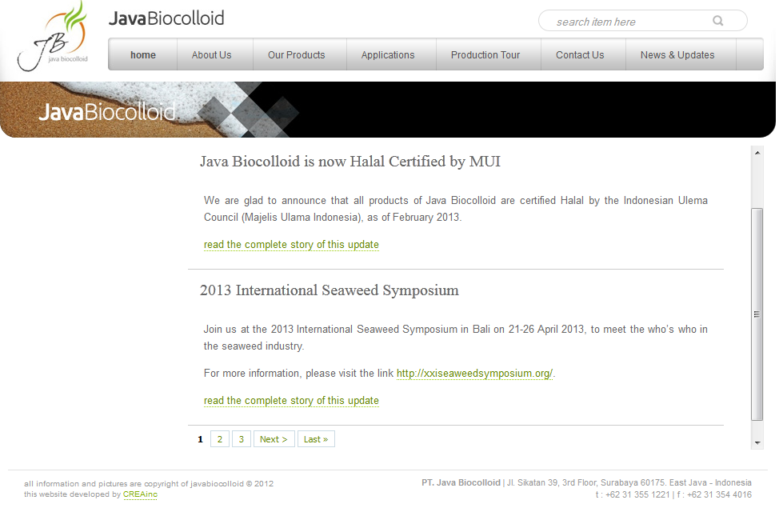

Slide 33
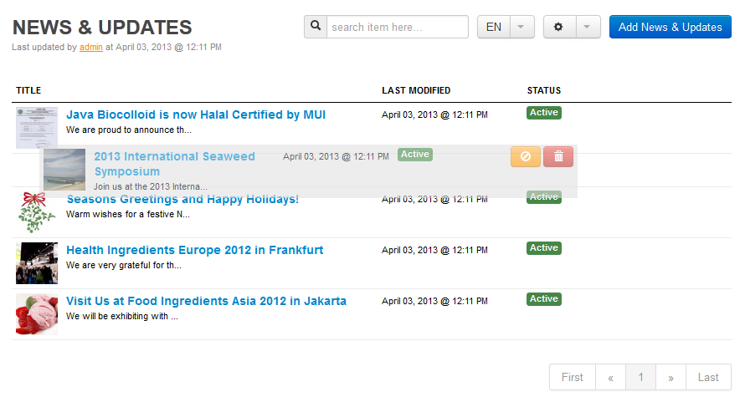

Slide 34
Front-End Content Editor
Basically, create, update, or even delete website content can only be done in Back-End layout.
For some custom request, those action can also be done in Front-End layout.

Slide 35
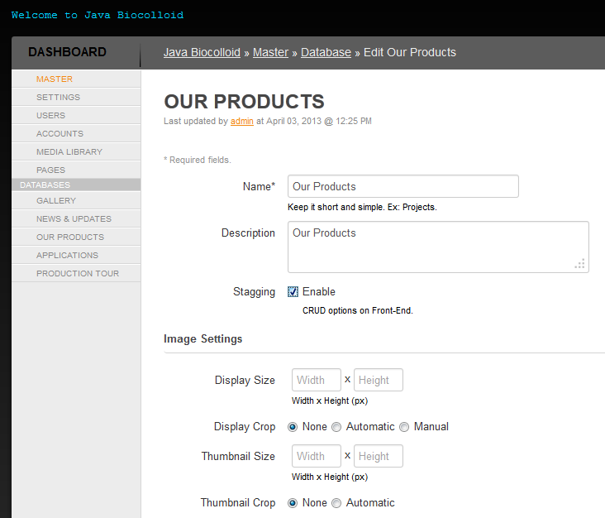

Slide 36
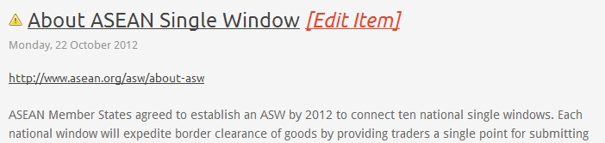
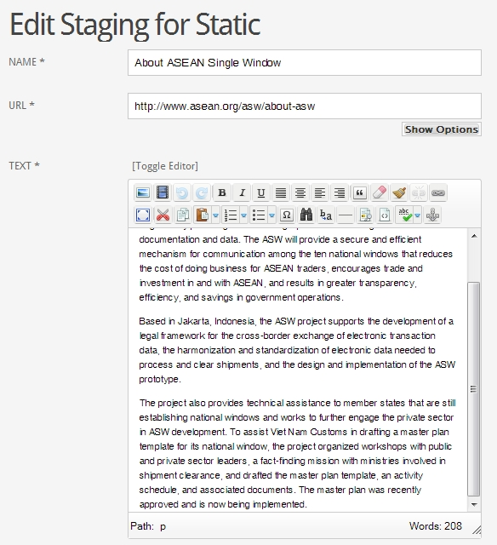

Slide 37
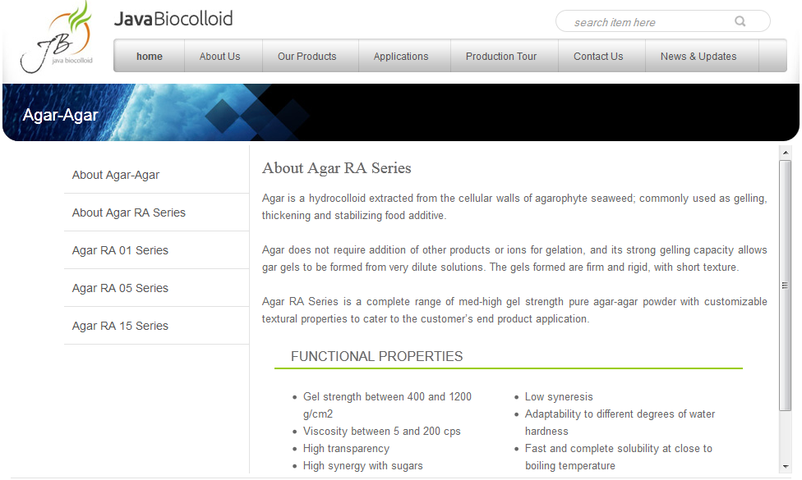
zPanel 4.0 Example

Slide 38
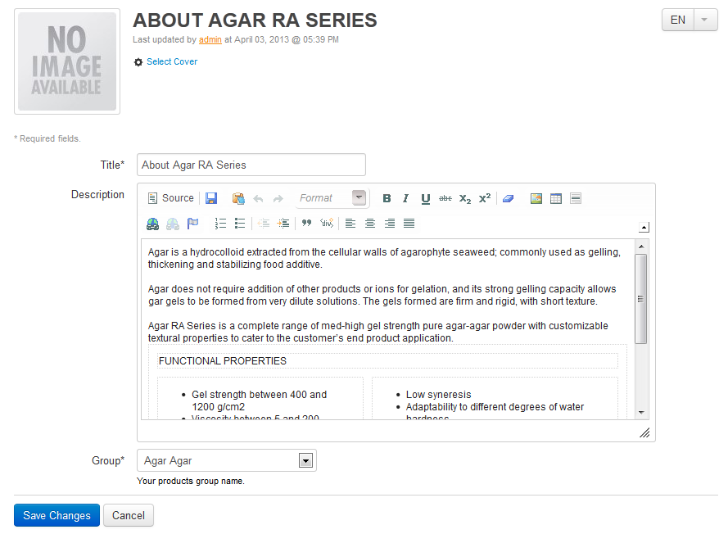

Slide 39
zCommerce 4.0 Plugin
Addition features that equip website with payment online transaction (paypal online).
For this version, shipping & handling just for indonesian residence (using JNE system).
These features suitable for online shop website, regardless whatever kind of products your business do.

Slide 40
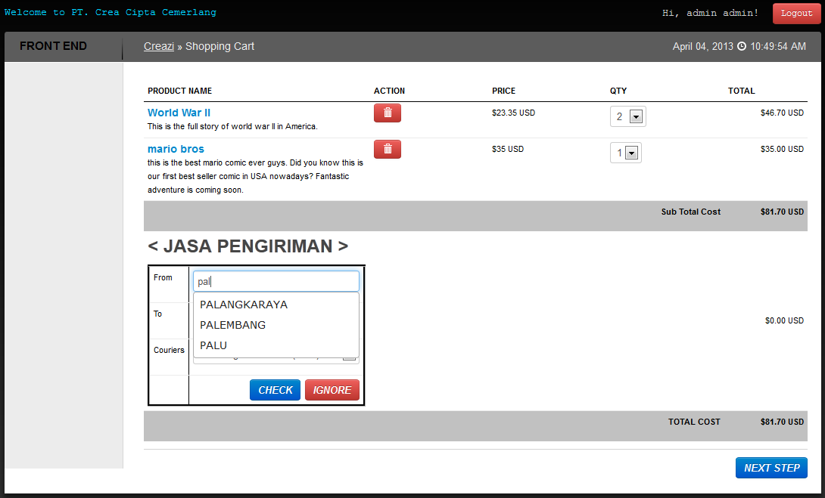
Shopping Cart Step 1

Slide 41
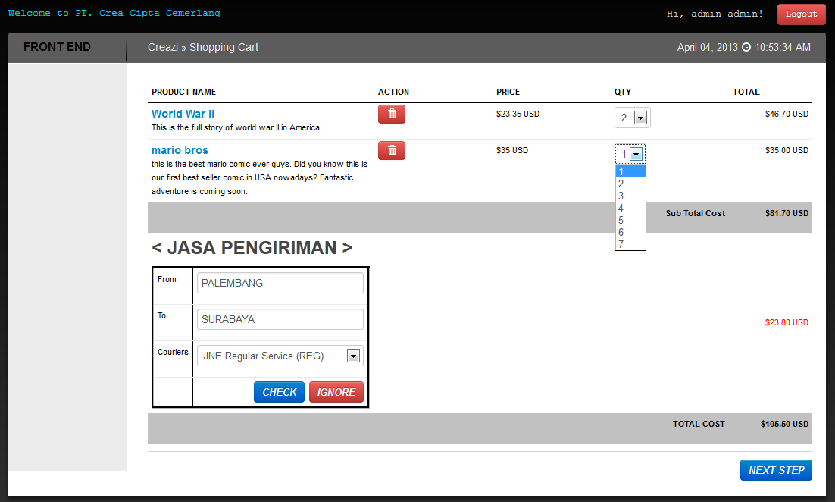
Shopping Cart Step 1 (cont.)

Slide 42
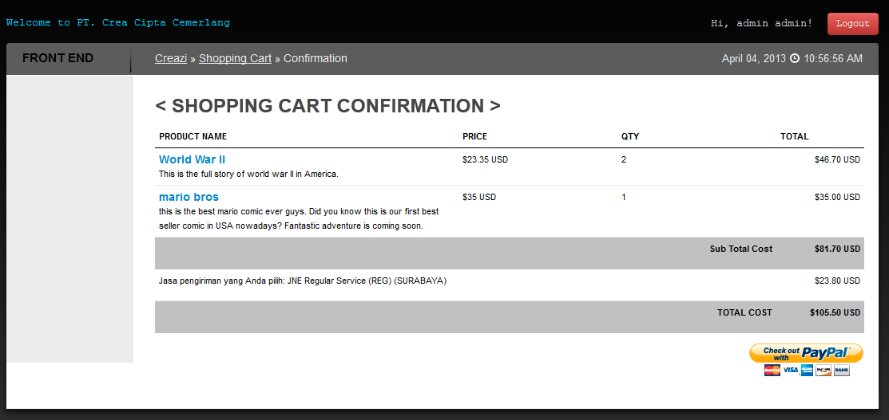
Shopping Cart Step 2

Slide 43
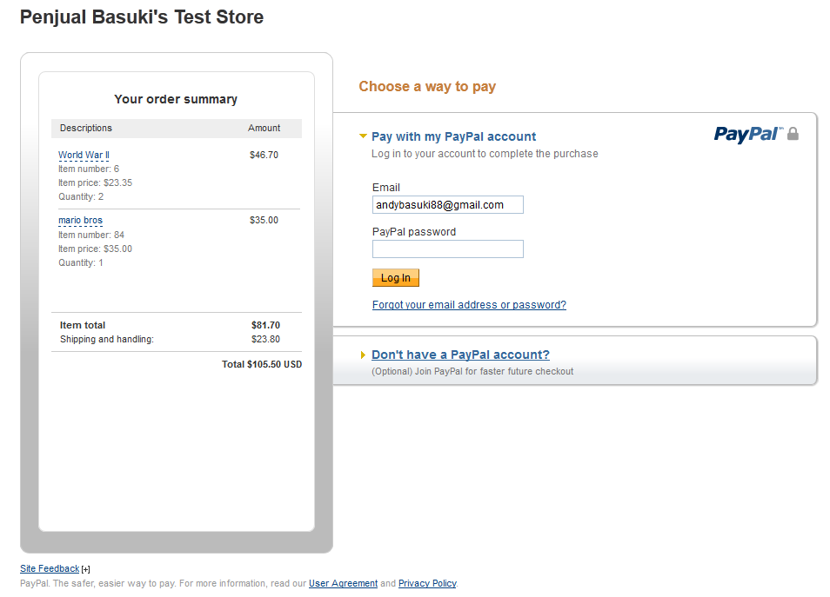

Slide 44
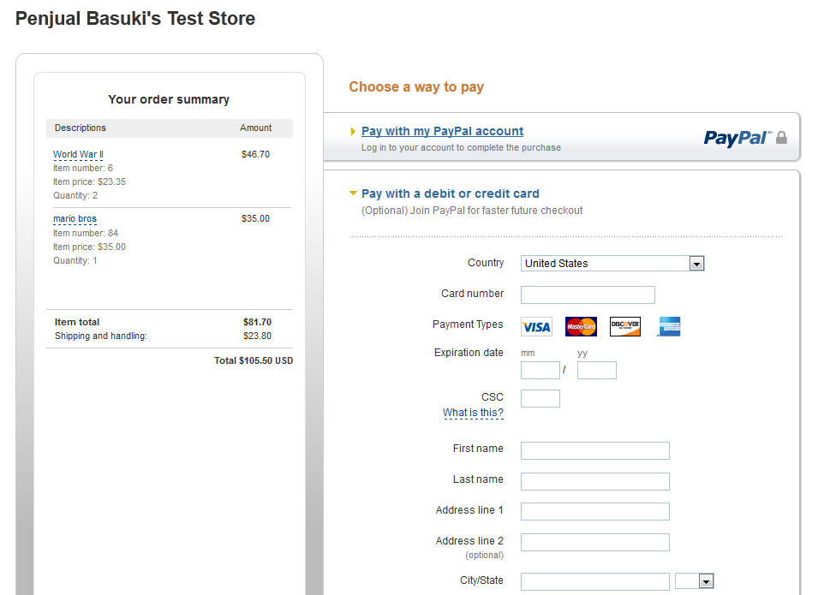

Slide 45
Izzi-POS (Point of Sale)
The place where a retail transaction is completed.
It is the point at which a customer makes a payment to a merchant in exchange for goods or services.
Izzi-POS is one of the website software solution.

Slide 46


Implementation Example

Slide 47
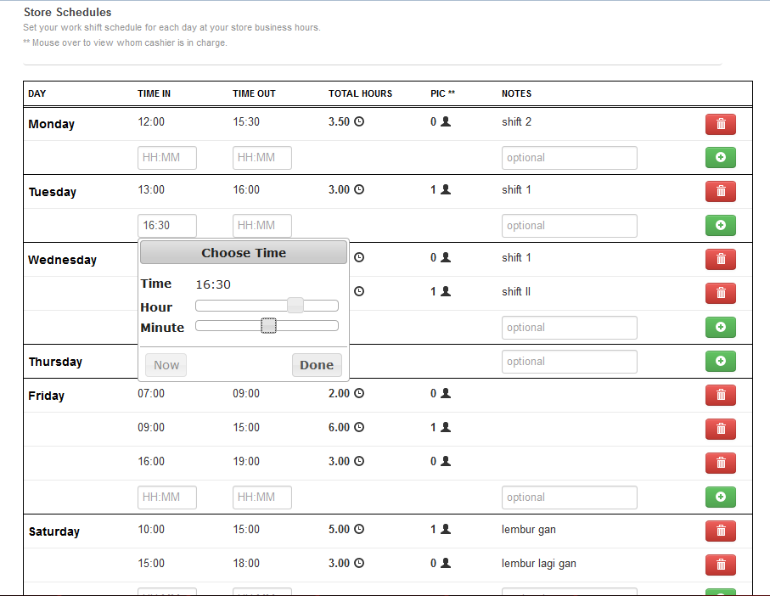

Slide 48
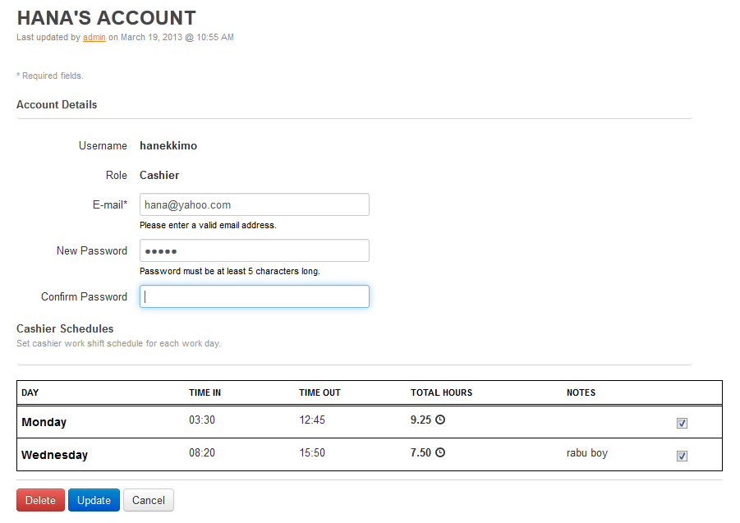

Slide 49
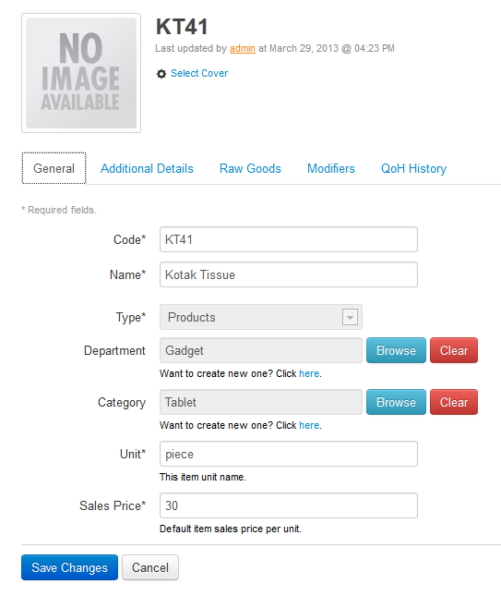

Slide 50
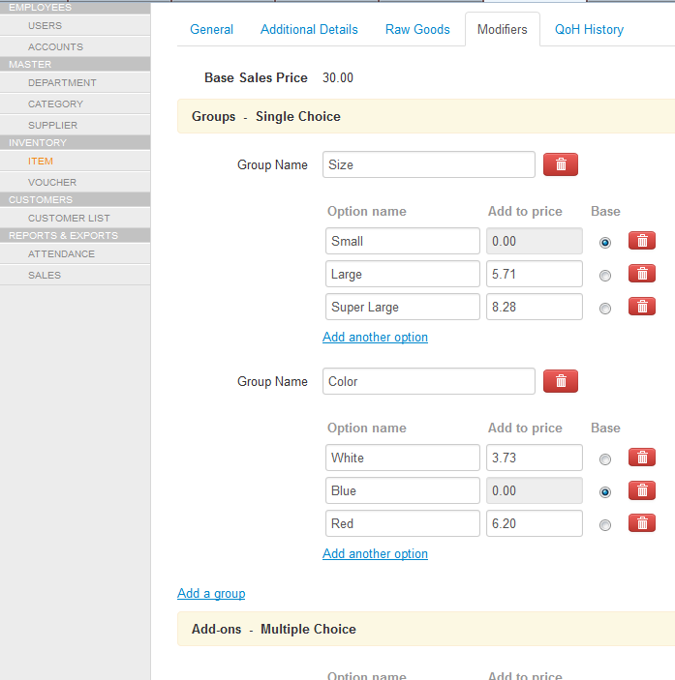

Slide 51
谢谢 Thank You 谢谢

